Slide 1
LED Technical Presentation
Aaron Wilhite
Notes:
-Introduce myself and Team #3 (Parking Lot Monitoring System)
-In charge of designing the sign
-Talk about how sign was constructed and what it does
-Due to this I am doing this presentation on LEDs

Slide 2
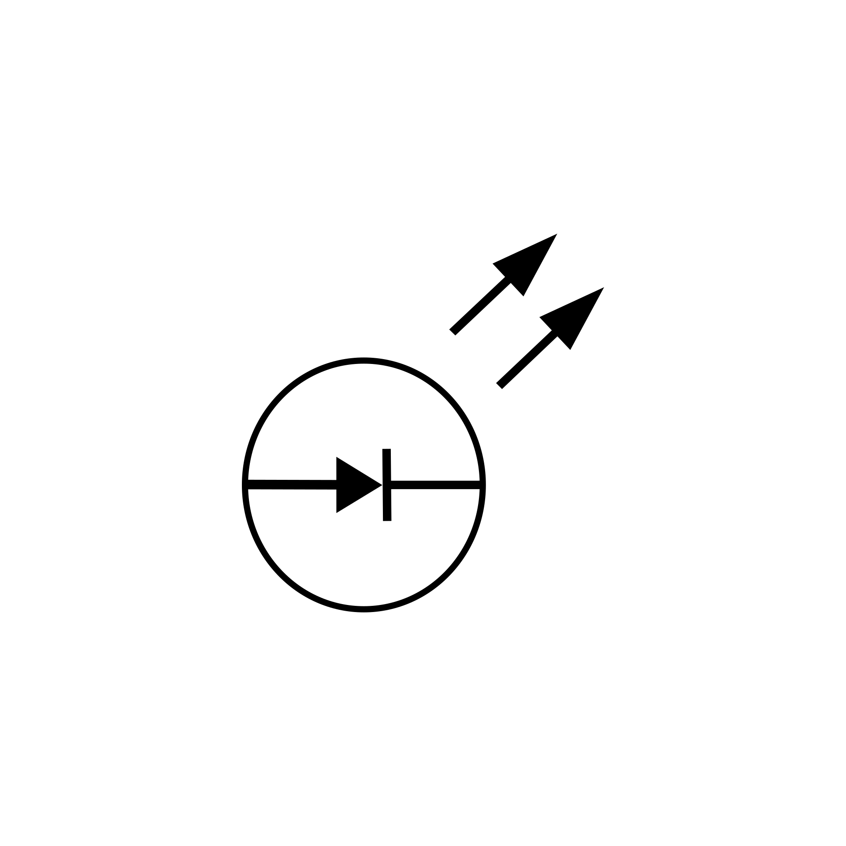
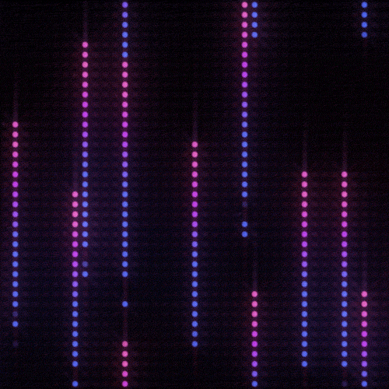
What are LEDs?
Light-Emitting Diodes
Circuit Symbol
Notes:
I know you all already know quite a bit about LEDs especially on the theoretical side which I will briefly cover, but I am hoping to at least teach you something new and cool you didn’t already know about LEDs
PRESS FOR ANIMATION
LEDs are Light Emitting Diodes like you all know
PRESS FOR ANIMATION
Here is the typical circuit symbol used and a cool little gif of some trailing LEDs in a strip

Slide 3
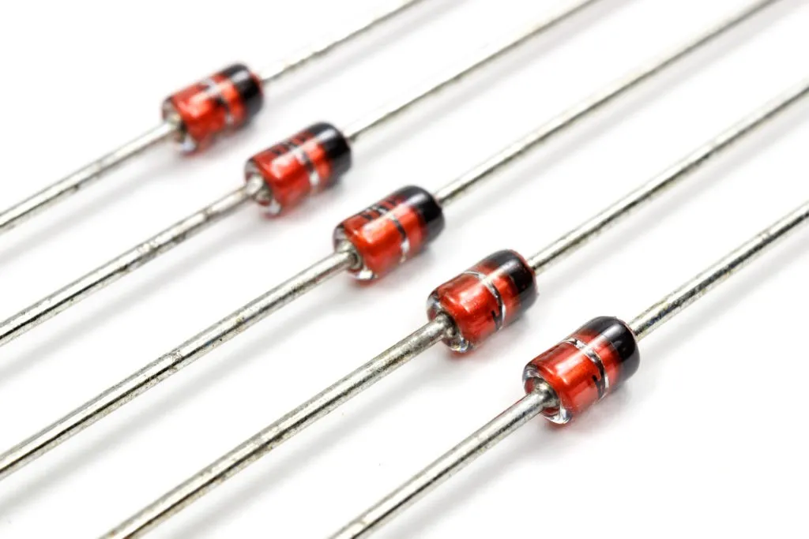
Well, What is a diode?
Control the direction of current flow
Used for rectification, voltage regulation, switching, etc.
LEDs are a special type of diode that converts electrical energy into light instead of heat
Zener Diodes
Notes:
Well, what is a diode??
control direction of flow
Used in rectification, voltage regulation, and switching
LEDs can be used to like other diodes, but are typically not as efficient.
LEDS - much higher forward voltage or voltage drop (necessary voltage to activate), much lower breakdown voltage and lower current rating, when compared to diodes
LEDs have a direct band gap emitting photons instead of dissipating energy as heat or phonons

Slide 4
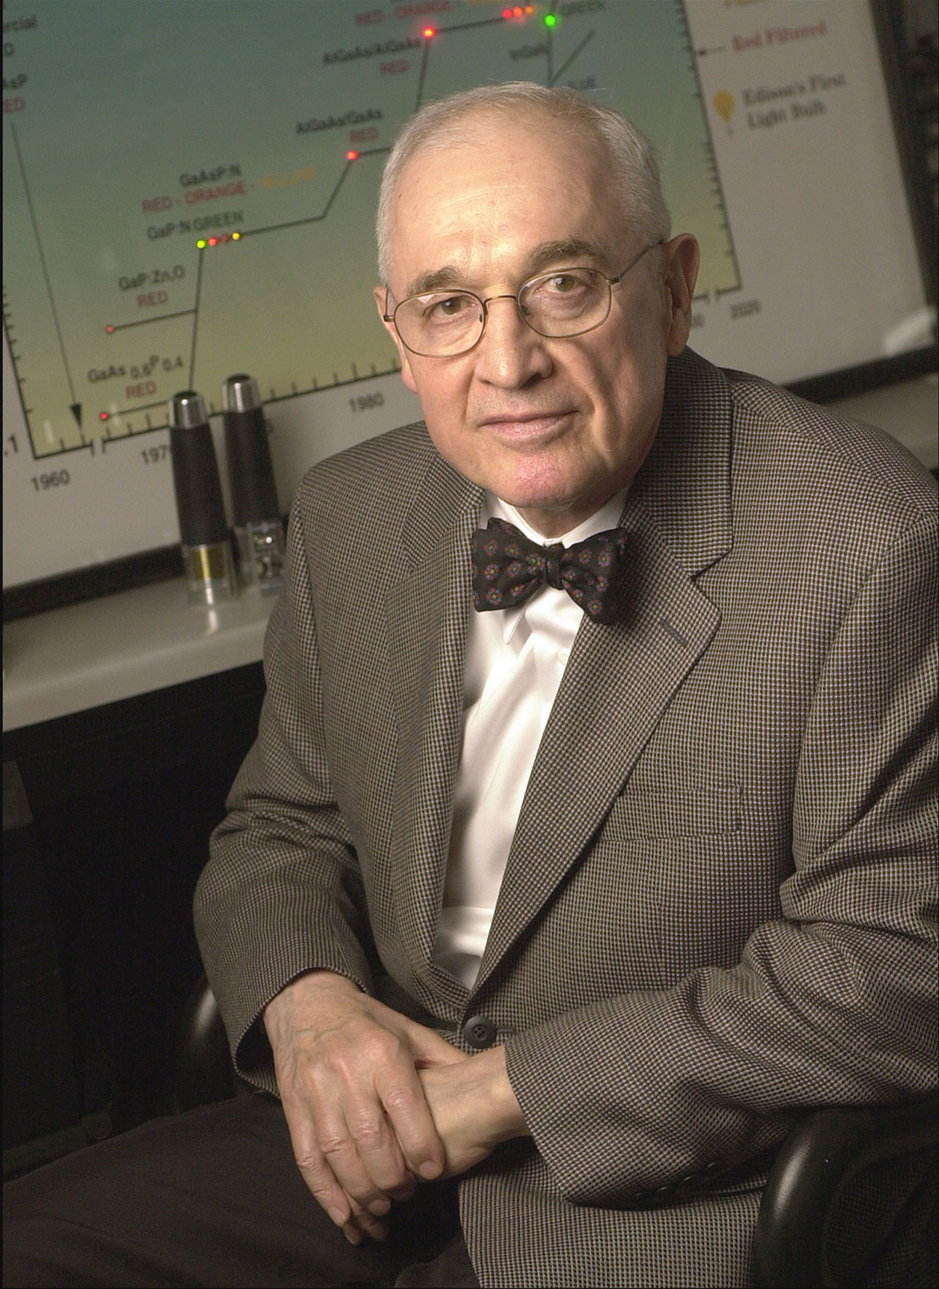
History of LEDs
Partially discovered in 1927 by Oleg Losev, with a silicon carbide semiconductor
Invented in 1962 by Nick Holonyak Jr.
Followed by green and yellow LEDs
Blue LEDs were developed in the 1990s, enabling white LEDs
Nick Holonyak Jr.
Notes:
Oleg Losev reported the first LED using silicon carbide (crystal rectifier diode), it ended up emitting some light when current passed through it,
His work ended up being ignored and largely forgotten with it only being documented in Soviet, Russian, and British journals.
Not much further documentation till the recognized invention by Nick Holonyak Jr., consulting engineer for General Electric who used gallium arsenide phosphide as a substrate and produced the first red LED.
The first green LED - by Egon Loebner and Rubin Braunstein in 1958. They used gallium phosphide
The first yellow LED was created by George Craford at Monsanto in 1972 by combining a red and a green diode
The first blue LED was developed by Isamu Akasaki and his team in 1989. The first white LED was made by Shuji Nakamura in 1993 by coating a blue LED with a yellow phosphor

Slide 5
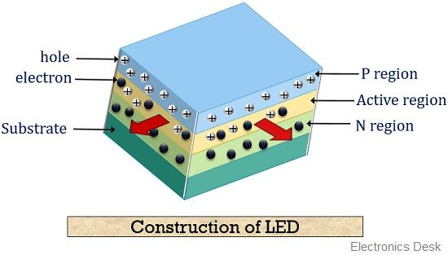
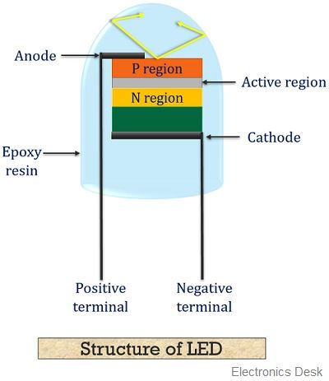
Construction
LEDs composed of different layers
Made from different materials like Gallium Arsenide, Gallium Nitride, Silicon Carbide, etc.
Positively charged layer (p-type)
Negatively charged layer (n-type)
Active Region
P-n junction is crucial for LED functionality and light emission
Notes:
Created by doping the material with impurities to create
p-region to typically have one less valence electron (acceptor region “ACCEPTS electron”)
N-region to typically have one more valence electron (donor region “DONATES electron”)
Different materials used for different semiconductors
Holes do not move by themselves, but they can accept electrons from the n region when a forward voltage is applied to the LED
Vf relates to Eg through Shockley diode equation
holes designed at top of the LED because the light emission occurs when electrons and holes recombine in the p region
- active region is where the action happens (recombination and light emission) not to be confused w/ depletion region (where no charge carriers are present)

Slide 6
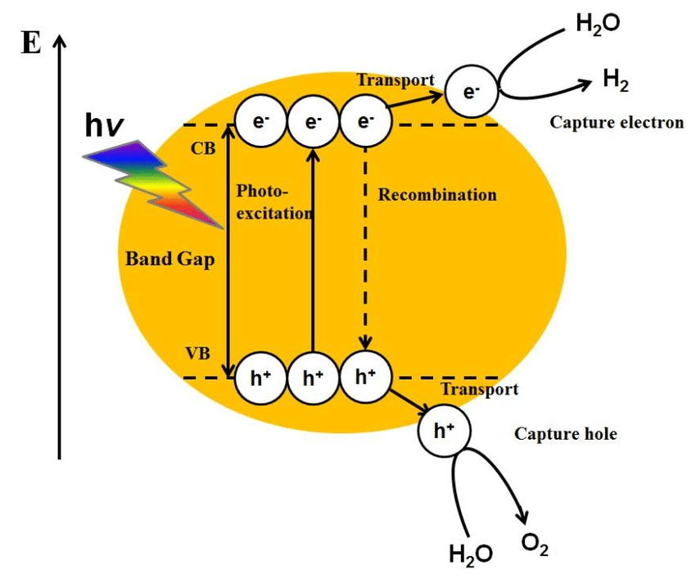
How do they work?
Electron-hole recombination
Wavelength (Color of LED) found through formula E = hc/λ
Notes:
Electron-hole recombination - process where electron in conduction band loses energy then falls back to the valence band, filling a hole and annihilating both carriers.
This releases energy, which can be in the form of photons (light) or phonons (heat)
where E is the bandgap energy in (eV), h is the Planck’s constant, c is the speed of light, and λ is the wavelength.
We will get into this more in a few slides

Slide 7
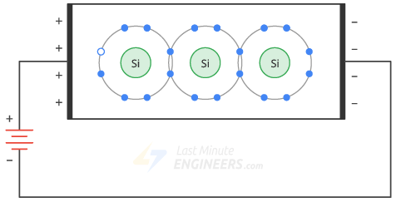
Notes:
-This is a somewhat decent visualization of the process
-Forward voltage being the necessary voltage to cause this reaction through a specific compound

Slide 8
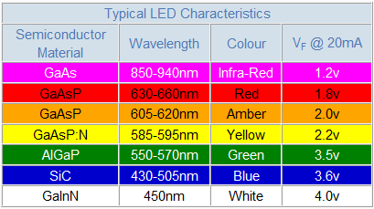
Wavelength - Compound - Color
Each compound has a different bandgap
In turn produces a different wavelength or frequency of light (aka different color)
Notes:
Like seen in the previous equation
Energy of photon relates to the wavelength and frequency of the light emitted (color)
Higher energy bandgap = the higher the energy of the photon = shorter the wavelength = higher frequency the light, and vice versa.
Different semiconductor materials have different energy bandgaps, which produce different colors of light.
The following show examples of colors, wavelengths and forward voltages necessary for specific material cases. Keep in mind that based on the ratios of the elements in each material can change the characteristics, this is just an example:
Gallium Arsenide
Gallium Arsenide Phosphide = red or amber based on arsenic content, more As = red, less = amber
Gallium Arsenide Phosphide doped with Nitrogen can make yellow with the right material ratio
Aluminum Gallium Phosphide
Silicon Carbide
Gallium Indium Nitride
Analyze the chart
Before LEDs different wavelengths of visible light were much harder to generate

Slide 9
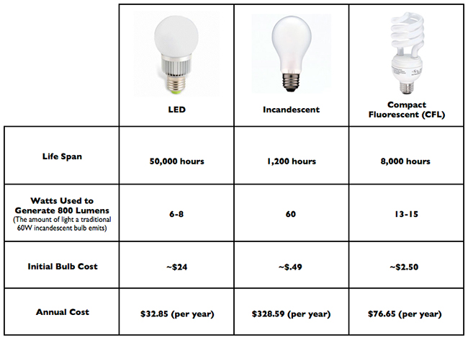
Advantages
Highly Efficient: LEDs consume up to 90% less energy than traditional incandescent bulbs.
Long lifespan: LEDs can last up to 50,000 hours or more.
Low maintenance costs: Due to less replacement from the long lifespan.
Notes:
Looking at the following chart comparing household bulbs, this more of a comparison from a consumer perspective
LEDs more efficient than incandescent bulbs and decently more than cfl bulbs
Convert nearly 100% of energy while incandescent convert only around 9-10%
Compare on the chart 50,000 - LED, 1,200 - Incand, 8,000 - CFL
LEDs can last over 50,000 hours with incandescent lasting around 1200 hours and cfls at around 8000 or so
The initial bulb cost vs the annual average power usage cost showing the benefits of LED tech.
The following are rough averages, but give an idea for comparison
LED $24 but annual cost of $32.85
Incandescent $0.49 but annual cost of $328.59
CFL $2.50 but annual cost of $76.65

Slide 10
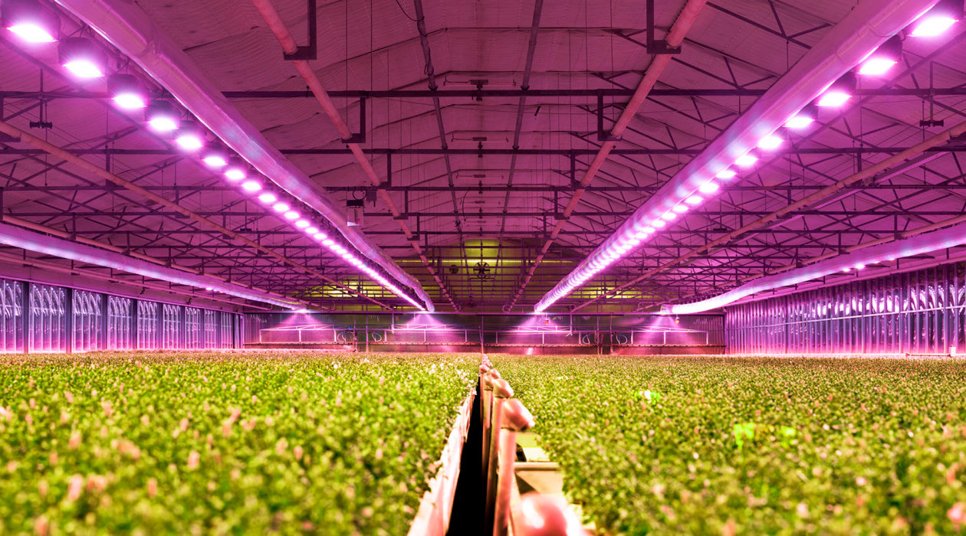
Applications
General lighting
Automotive lighting
Horticulture: specialized LEDs for plant growth
Display technology
Medical applications
Notes:
a. General lighting - homes, offices, and public spaces
Brighter, more efficient like seen in previous slide
b. Automotive - headlights, taillights, and interior lighting
Previous slides concepts apply to this as well
c. Horticulture - specialized LEDs for plant growth
LEDs:
roles in horticultural lighting: tissue culture, production, supplemental, and photoperiod lighting
Have unique capabilities such as spectral composition control, high light output with low radiant heat, this helps not to overheat sensitive plants
At different wavelengths of light that can influence the production of volatile compounds, antioxidants, and sugars in plants, which affect their flavor and aroma
LEDs can also vary the intensity and duration of light, which can affect the ripening and maturation of fruits and vegetables, which affect their color, firmness, and sweetness
LEDs can have different effects on different crops, depending on their light requirements and responses. For example, far-red light can enhance the flavor of tomato, strawberry, and blueberry, but reduce the flavor of sweet basil
Can also suppress microbial growth on crops by using specific wavelengths such as 437 nm, which can extend their shelf life and freshness
d. Display technology
Used in phones, TVs, monitors and more
Higher resolution recently possible due new technology like QLEDs and OLEDs which will be covered in the next slide
e. Medical applications - like phototherapy, surgical lighting and disinfection
Phototherapy is the use of light to treat various conditions, such as jaundice, psoriasis, eczema, vitiligo, and depression.
LEDs can provide specific wavelengths of light that have therapeutic effects on the skin or the brain.
blue LEDs can help break down bilirubin in newborns with jaundice
while red and infrared LEDs can stimulate wound healing and reduce inflammation.
LEDs can be used for disinfection by emitting UV light. This can damage DNA and RNA of microorganisms such as bacteria, viruses and fungi.
Therefore, UV LEDs can be used to disinfect lots of equipment in medical environments.

Slide 11
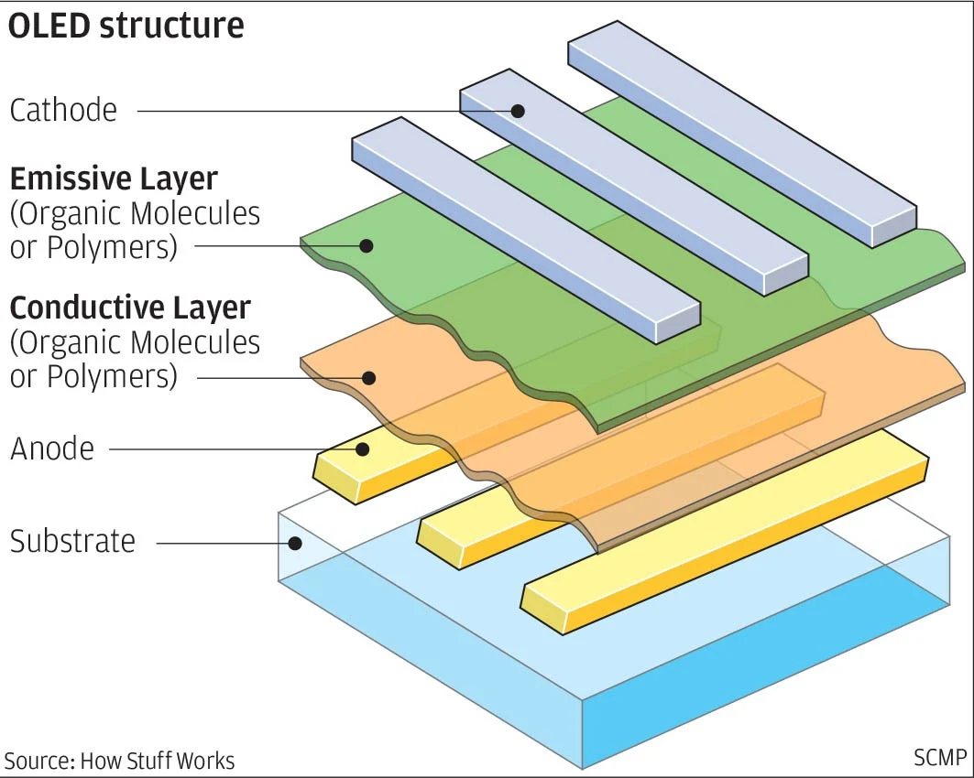
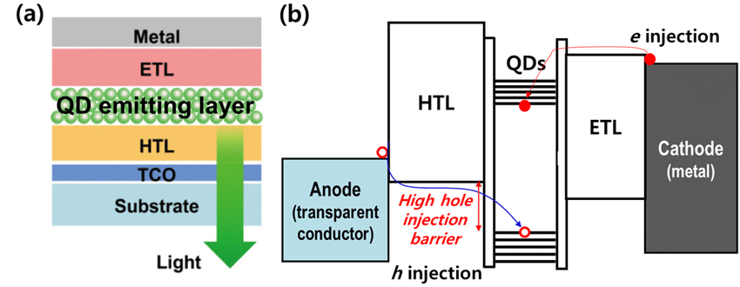
Recent Advancements
Phosphor-converted LEDs - better color rendering and white light quality
Quantum dot LEDs (QLEDs) - improved color and brightness
Organic LEDs (OLEDs) - thin, lightweight, and flexible displays
Li-Fi - data transmission through visible light communication
Has the potential to reach speeds of up to 224 Gbps
Notes:
a. Phosphor-converted LEDs
1st off phosphors (can be different materials) in this case are materials that emit light when exposed to radiant energy (not
phosphorus)
They use phosphor to absorb some light emitted and re-emit at a different wavelength
Allows for a lot of flexibility when color mixing and color rendering
b. Quantum dot LEDs (QLEDs)
QLEDs use quantum dots (QDs), which are tiny particles that emit light when excited by typically a blue or near-UV LED.
QDs are nanoscale particles that can emit light of different colors depending on their size
These are mainly seen in newer premium TVs
The theory behind these would take a whole other presentation to cover
c. Organic LEDs (OLEDs)
OLEDs are organic LEDs that use a film of organic compound to emit light compared to traditional LEDs using
inorganic compounds
can display deep black levels and high contrast ratios
OLEDs can be thin, flexible, and transparent
d. Li-Fi - data transmission through visible light communication
Li-Fi use LEDs to modulate light signals received by photodetectors
Li-Fi can achieve high data rates, low latency, high security, and low interference
Li-Fi has the potential to reach speeds of up to 224 Gbps (Gigabits/sec) REALLY FAST
Li-Fi can also be useful in areas where electromagnetic interference is a problem, such as aircraft cabins or hospitals
Similar concept to IR but uses visible light

Slide 12
Conclusion
LEDs are a versatile and efficient lighting technology that have transformed the lighting industry.
Their energy efficiency, long lifespan, and low maintenance costs make them an attractive option for a wide range of applications.
As technology continues to advance, we can expect to see even more innovative uses of LED technology in the future.
Notes:
In conclusion
LEDs are extremely versatile and efficient
Their energy efficiency, long lifespan, and low maintenance costs make great for a wide range of applications.
As technology continues to advance, we can expect to see even more innovative uses of LED technology in the future.

Slide 13
Sources
[1] “Light-emitting diode.” Wikipedia, Wikimedia Foundation, https://en.wikipedia.org/wiki/Light-emitting_diode.
[2] “How LED producing different colours?” Electronics Gurukulam, 26 Aug. 2012, https://electronicsgurukulam.blogspot.com/2012/08/how-led-producing-different-colours.html.
[3] “Light Emitting Diode (LED).” Electronics Reference, https://electronicsreference.com/module5/light_emitting_diode/.
[4] “Light Emitting Diode (LED).” Electronics Desk, https://electronicsdesk.com/light-emitting-diode.html.
[5] “Flow of Free Electrons and Holes.” Last Minute Engineers, 2020, https://lastminuteengineers.b-cdn.net/wp-content/uploads/basic/Flow-of-Free-Electrons-and-Holes.gif.
[6] “NASA Research Illuminates Medical Uses of Light.” NASA Spinoff, 19 May 2022, https://spinoff.nasa.gov/NASA-Research-Illuminates-Medical-Uses-of-Light.
[7] Lee, Changhee & BAE, Wanki & Kwak, Jeonghun. (2014). Quantum Dot LED (QLED) Emerging as a Next-generation Display Technology. Physics and High Technology. 23. 33-39. 10.3938/PhiT.23.048.
[8] Yau, Josh. “What is OLED and why should you pay more to have it in your phone?” South China Morning Post, South China Morning Post Publishers Ltd., 25 Sept. 2017, https://www.scmp.com/tech/apps-gaming/article/2111278/what-oled-and-why-should-you-pay-more-have-it-your-phone.

